Slide 1
Object Detection

Slide 2
Objectives
What is Object Detection?
The techniques used in object detection.
Learn about face detection
Pedestrian detection
Applications of face detection
Object detection challenges

Slide 3
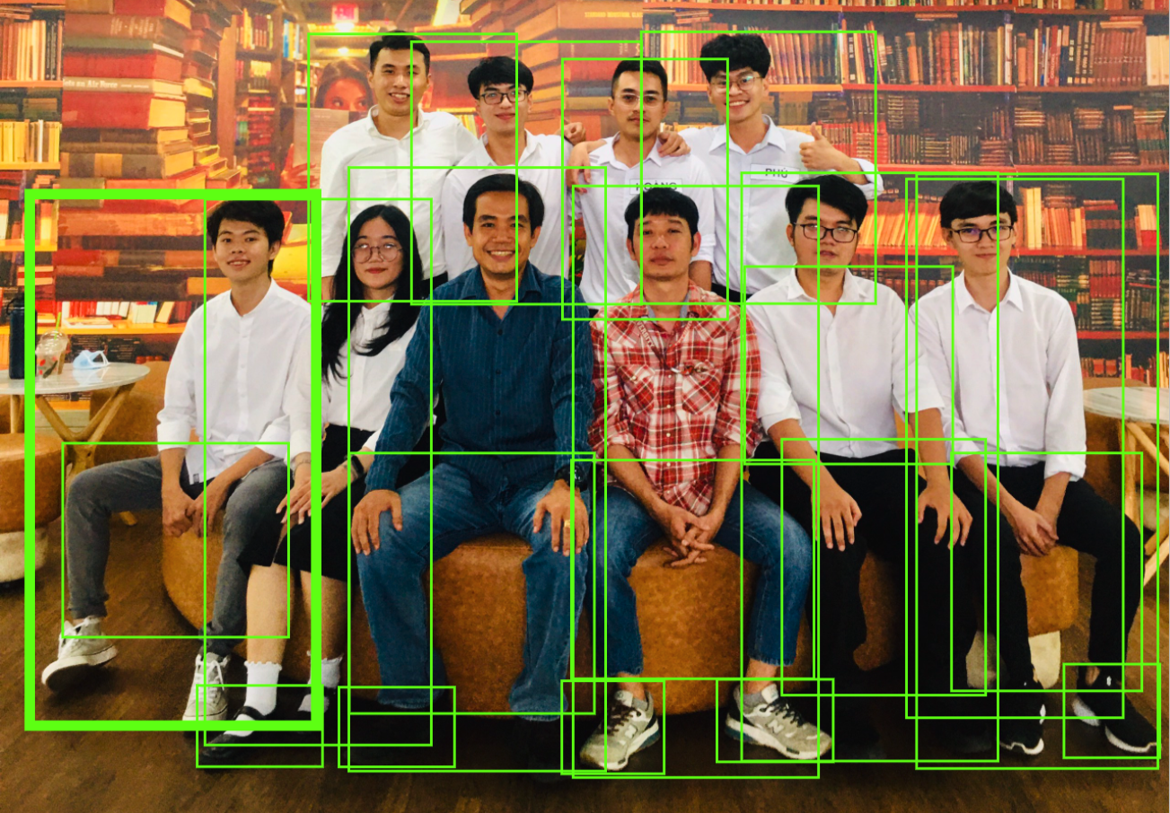
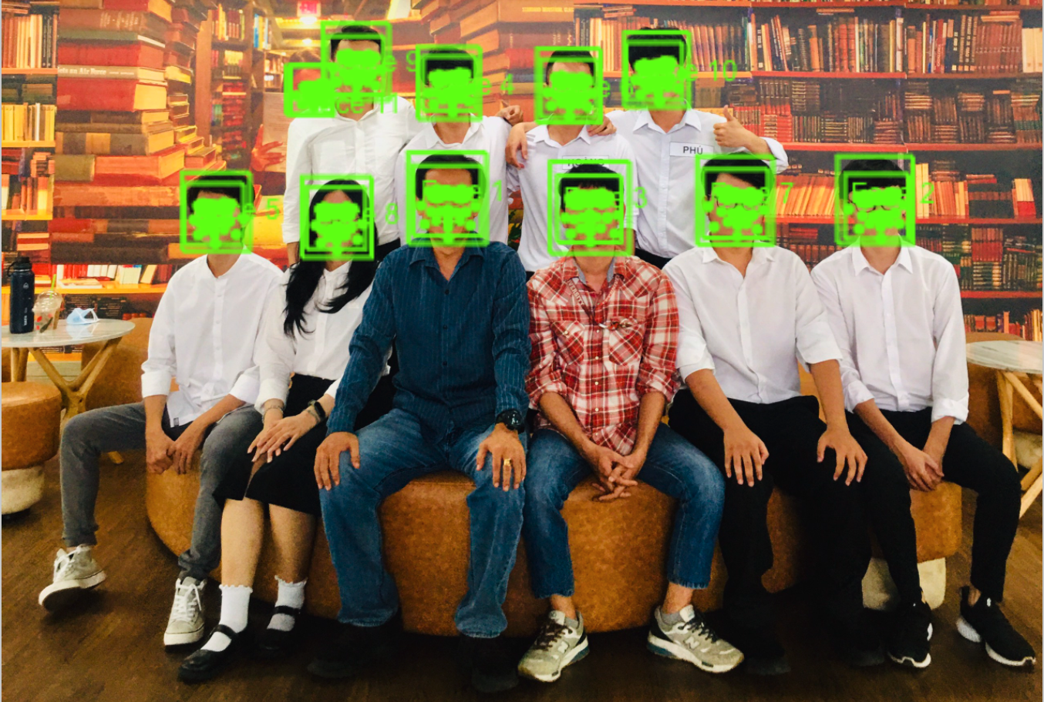
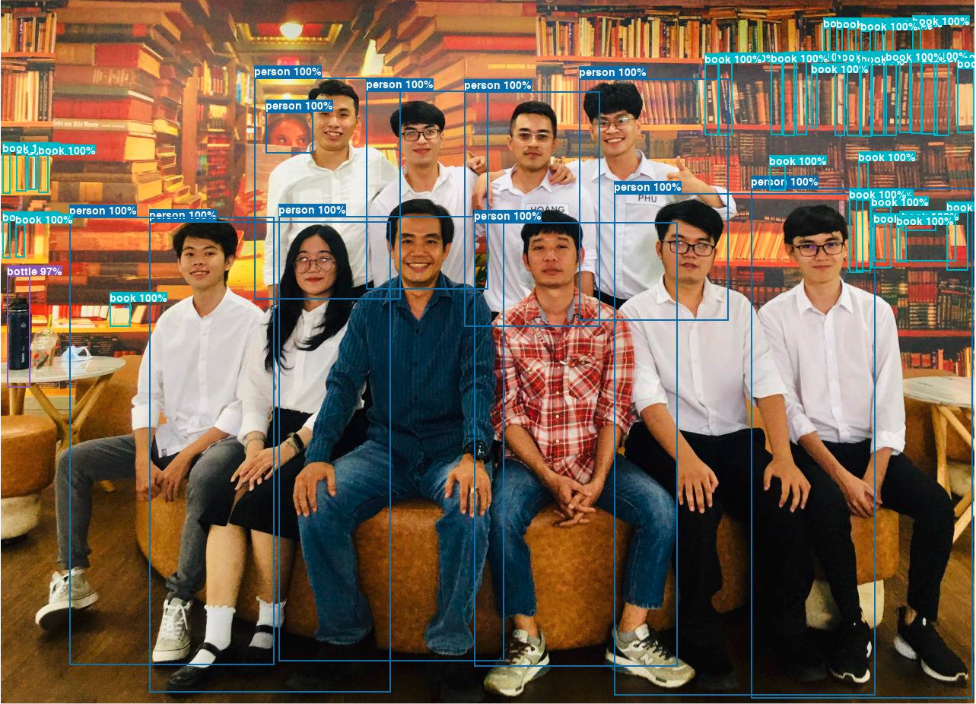
What is Object Detection?
Object detection???

Slide 4
What is Object Detection?
Object detection is the task of detecting instances of objects of a certain class within an image.
Object detection allows us to identify and locate objects in an image or video.
Object detection deals with detecting instances of semantic objects of a certain class (such as humans, buildings, or cars) in digital images and videos.
Object detection is merely to recognize the object with a bounding box in the image.

Slide 5
Object Detection Concept
Every object class has its own special features that help in classifying the class – Object class detection uses object special features
Examples:
Circles: objects that are at a particular distance from a center.
Squares, objects that are perpendicular at corners and have equal side lengths.
Face: eyes, nose, and lips can be found, and features like skin color and distance between eyes

Slide 6
Object Detection methods
Non-neural approaches:
Viola–Jones object detection framework based on Haar features
Scale-invariant feature transform (SIFT)
Histogram of oriented gradients (HOG) features
Neural network approaches:
Region Proposals (R-CNN, Fast R-CNN, Faster R-CNN, cascade R-CNN)
Single Shot MultiBox Detector (SSD)
You Only Look Once (YOLO)
Single-Shot Refinement Neural Network for Object Detection (RefineDe)
Deformable convolutional networks

Slide 7
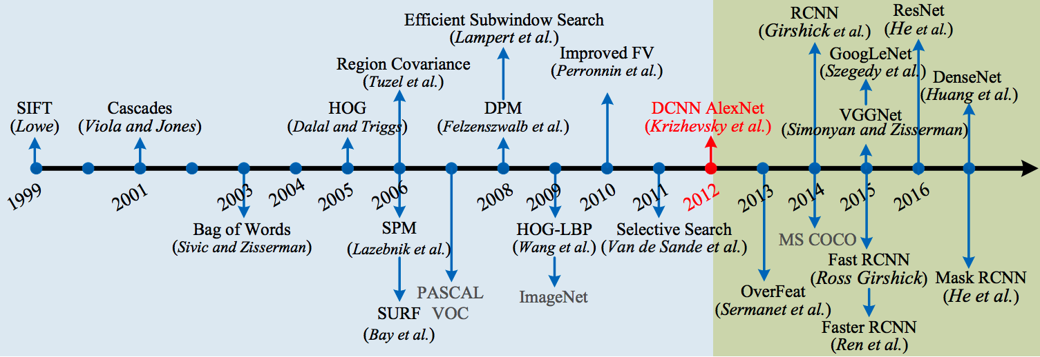
Object Detection methods

Slide 8
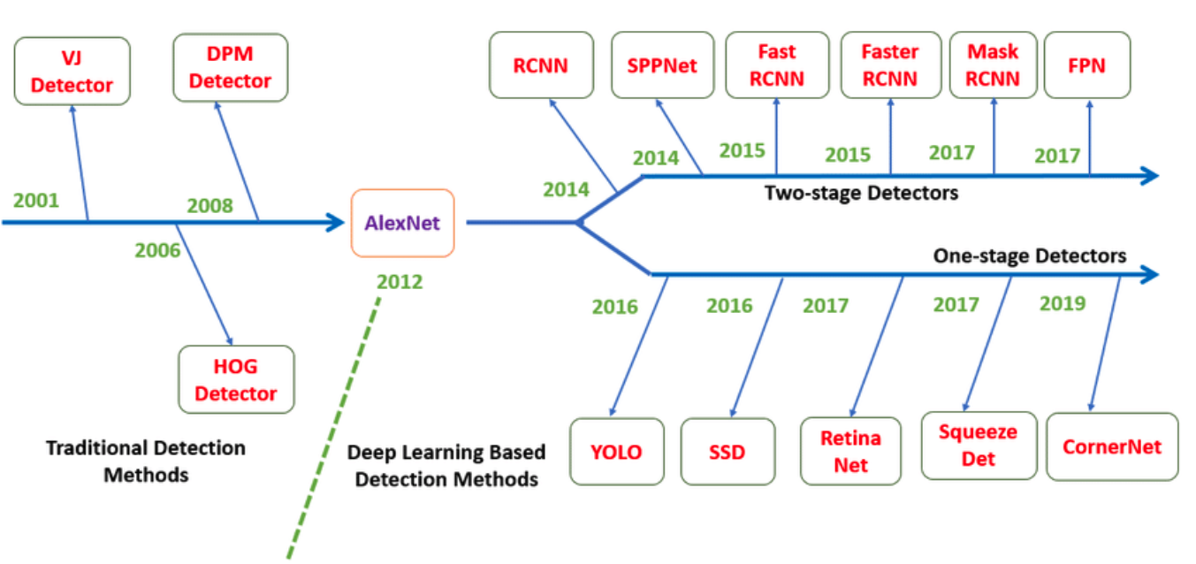
Object Detection methods

Slide 9

Face Detection
The face detection system will confirm detection by overlaying a rectangle on each face in the scene displayed on the camera's LCD

Slide 10
Face Detection
Face detection is that identifies human faces in digital image. It refers to the psychological process by which humans locate and attend to faces in a visual scene.
Face-detection algorithms focus on the detection of frontal human faces.
Face Features:
Eyes
Eyebrows
Nose
Mouth
Jaw

Slide 11
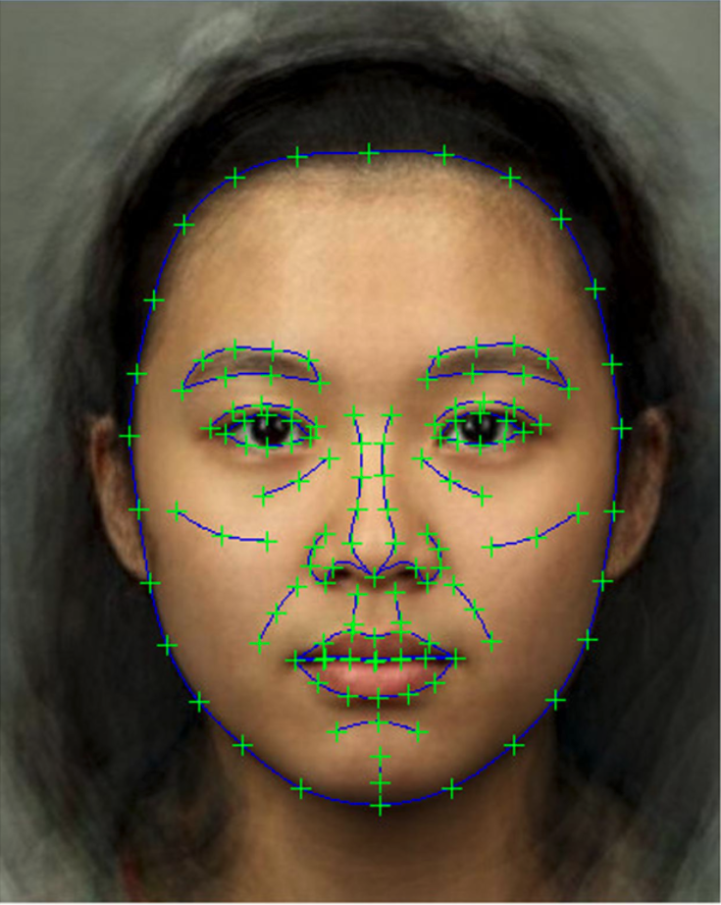
Face Detection
Face Features:
Eyes
Eyebrows
Nose
Mouth
Jaw

Slide 12
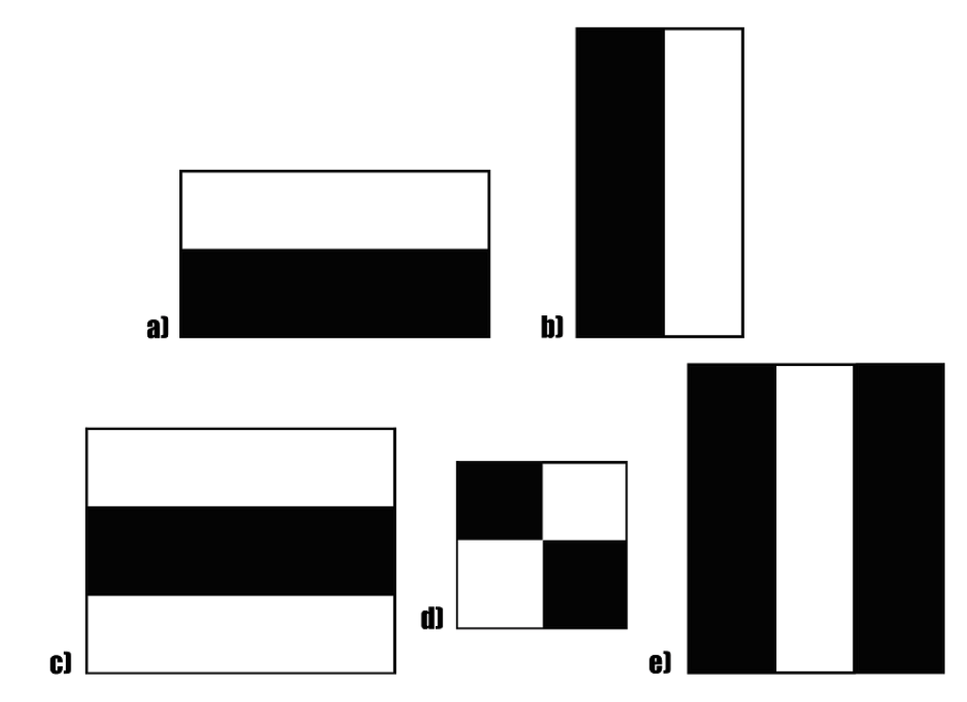
Face Detection - Haar Cascade
The algorithm uses edge or line detection features
These features on the image makes it easy to find out the edges or the lines in the image, or to pick areas where there is a sudden change in the intensities of the pixels.

Slide 13
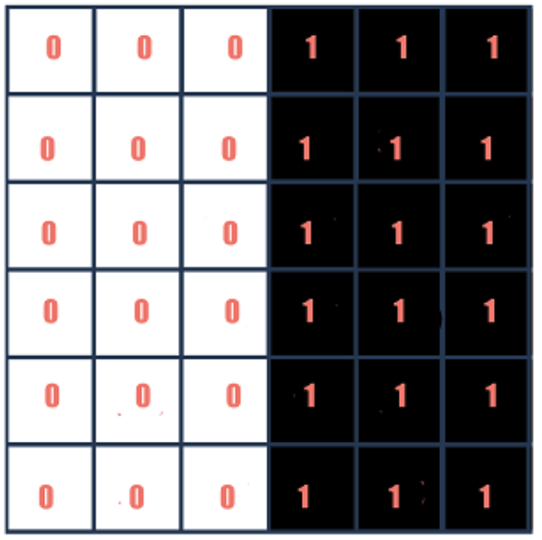
Face Detection - Haar Cascade
The haar calculation is done by finding out the difference of the average of the pixel values at the darker region and the average of the pixel values at the lighter region. If the difference is close to 1, then there is an edge detected.

Slide 14
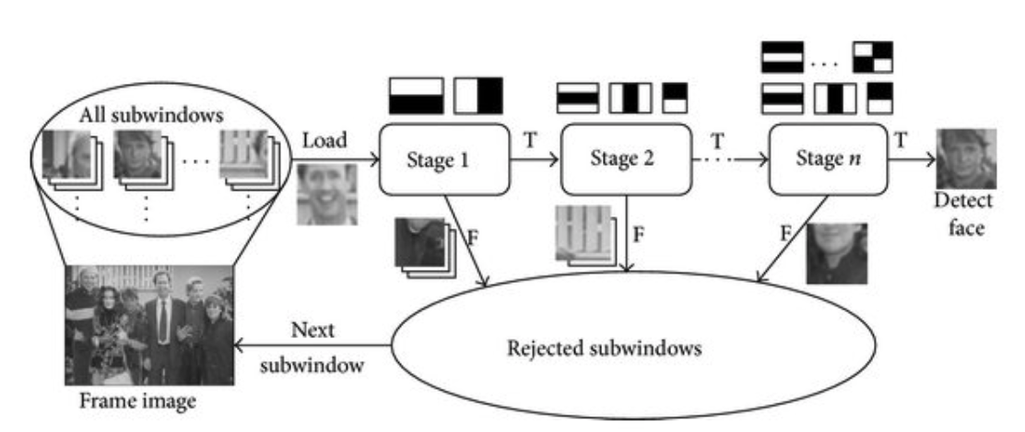
Face Detection - Haar Cascade

Slide 15
Face Detection - Haar Cascade
Steps:
Step 1: The image (that has been sent to the classifier) is divided into small parts (or subwindows as shown in the illustration)
Step 2: We put N no of detectors in a cascading manner where each learns a combination of different types of features from images are passed through. Supposedly when the feature extraction is done each sub-part is assigned a confidence value.
Step 3: Images (or sub-images) with the highest confidence are detected as face and are sent to the accumulator while the rest are rejected. Thus the cascade fetches the next frame/image if remaining and starts the process again.

Slide 16
Face Detection - Histogram of oriented gradients
Input image
1.
Gradient extraction
2. Histogram extraction
3. SVM
Human/Non-human face

Slide 17
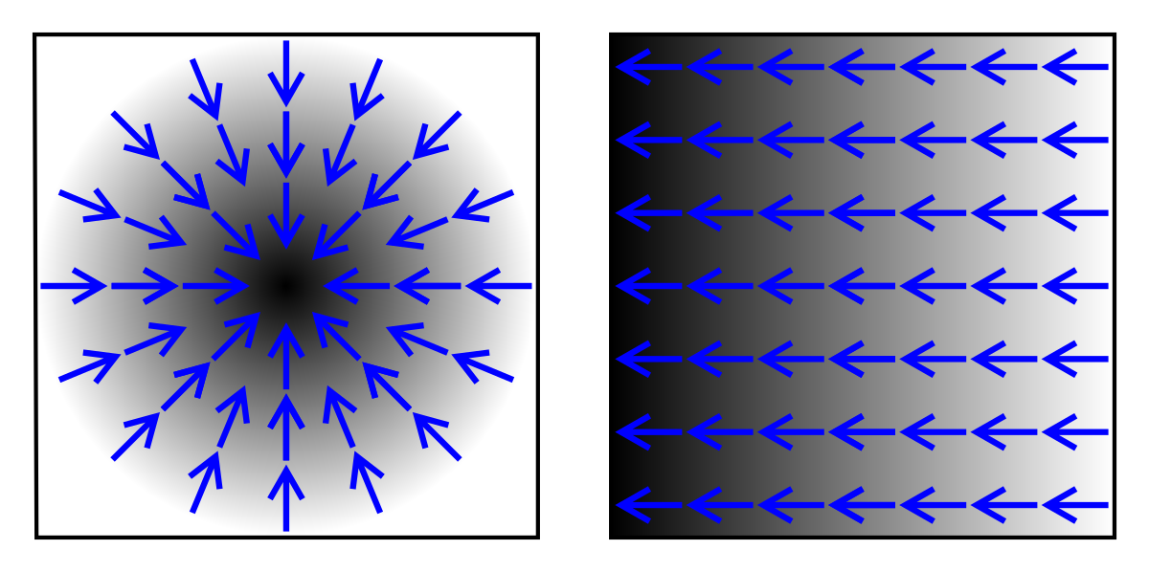
Face Detection - Histogram of oriented gradients
An image gradient is a directional change in the intensity or color in an image.
Gradients can be used for extracting the useful information (structure, feature, and properties of objects) from images.
Purpose: To calculate the magnitude and direction of gradient
Two types of gradients, with blue arrows to indicate the direction of the gradient. Dark areas indicate higher values

Slide 18
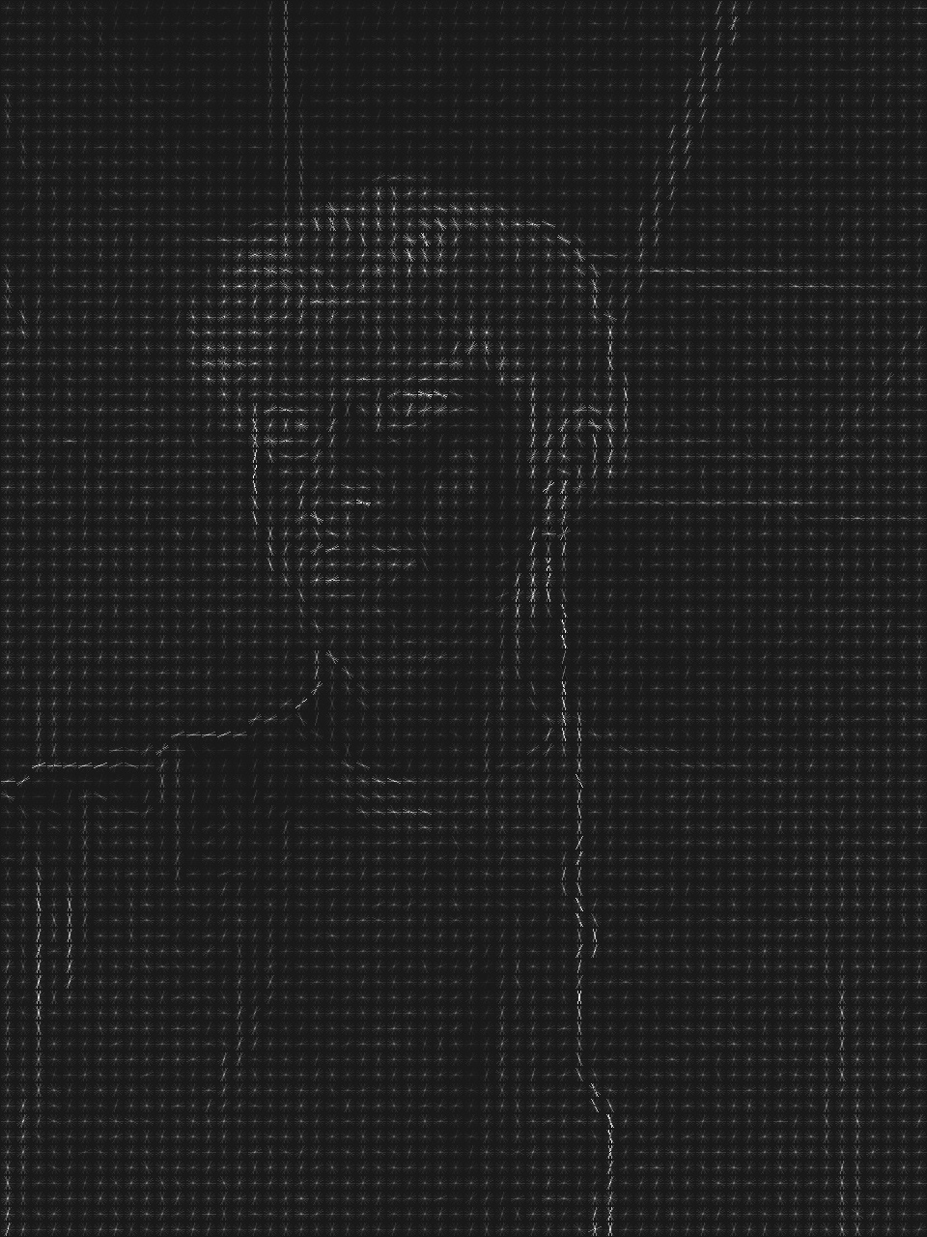
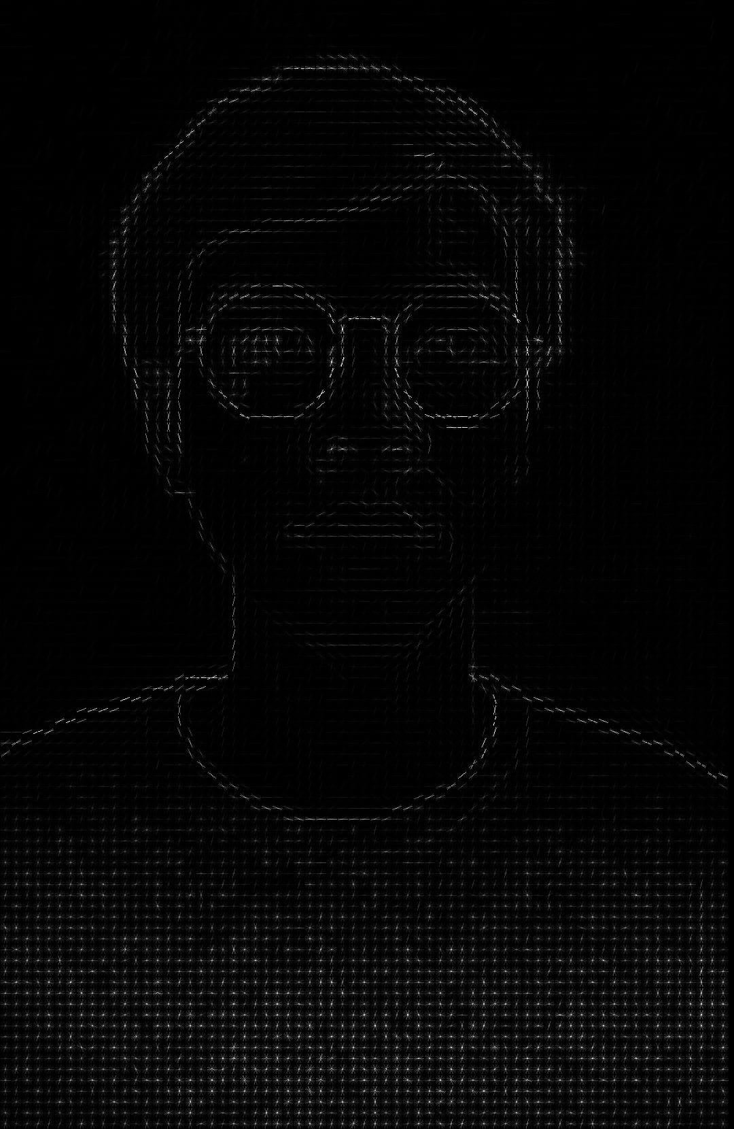


Face Detection - Histogram of oriented gradients
In face images, the important features of the size, shape, and face orientation are in points of the lines of eyes, nose, lips, and cheekbones
Images after calculating magnitude and direction

Slide 19
Face Detection - Histogram of oriented gradients
We use a window slide on frame from left to right and top to bottom to calculate magnitude and direction for every pixel
To detect face from multiple scales and locations, we slide with 4 sizes of window concurrently:
108x108
90x90
74x74
62x62

Slide 20
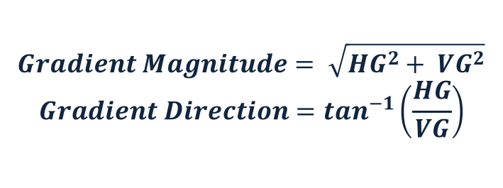
Face Detection - Histogram of oriented gradients
$$Gradient Magnitude= \sqrt{{HG}^{2}+ {VG}^{2}}$$
$$Gradient Direction=\tan^{−1}\left(\frac{HG}{VG}\right)$$
HG and VG is directional gradient with:
HG is Horizontal gradient
VG is Vertical gradient

Slide 21
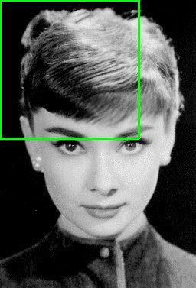
Face Detection - Histogram of oriented gradients
An
-1 | 0 | 1
 |  |  |  | …
 |  |  |  | …
 |  |  |  | …
 |  |  |  | …
 |  |  |  | …
… | … | … | … | …
Centred
-1 | 1
Un-centred
1 | -8 | 0 | 8 | -1
Cubic-corrected
108x108 kernel
Slide directional gradient on kernel

Slide 22
Face Detection - Histogram of oriented gradients
-1 | 0 | 1
-1
0
1
-1
0
1
Horizontal vector
-1 | 0 | 1
 |  |  |  | …
 |  |  |  | …
 |  |  |  | …
 |  |  |  | …
 |  |  |  | …
… | … | … | … | …
Vertical vector
108x108 kernel
Slide directional gradient on kernel

Slide 23
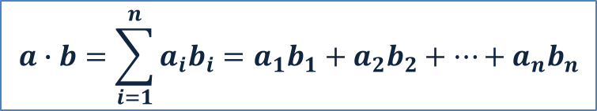
Face Detection - Histogram of oriented gradients
-1 | 0 | 1
 |  |  |  | …
 |  |  |  | …
 |  |  |  | …
 |  |  |  | …
 |  |  |  | …
… | … | … | … | …
Using dot product to calculate directional gradient
The dot product of two vectors
a = [a₁, a₂, …, a_{n}] and b = [b₁, b₂, …, b_{n}] is defined as:
$$a∙b=\sum_{i=1}^{n}{a_{i}b_{i}=a_{1}b_{1}+a_{2}b_{2}+…+a_{n}b_{n}}$$
108x108 kernel

Slide 24
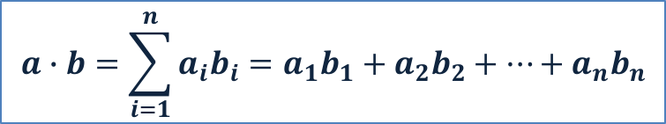
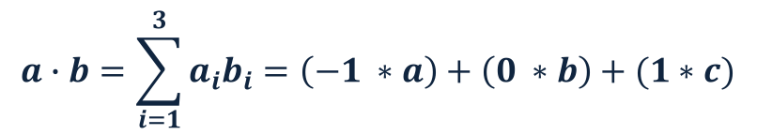
Face Detection - Histogram of oriented gradients
-1 | 0 | 1
 |  |  |  | …
 |  |  |  | …
 |  |  |  | …
 |  |  |  | …
 |  |  |  | …
… | … | … | … | …
Using dot product to calculate directional gradient
The dot product of two vectors
a = [a₁, a₂, …, a_{n}] and b = [b₁, b₂, …, b_{n}] is defined as:
$$a∙b=\sum_{i=1}^{n}{a_{i}b_{i}=a_{1}b_{1}+a_{2}b_{2}+…+a_{n}b_{n}}$$
108x108 kernel
n = 3
a:
-1 | 0 | 1
b:
a | b | c
Horizontal vector
3x3 vector at slide position
$$a∙b=\sum_{i=1}^{3}{a_{i}b_{i}=\left(−1 ∗a\right)+\left(0 ∗b\right)+(1∗c)}$$

Slide 25
Face Detection - Histogram of oriented gradients
?
What is HOG?
HOG is a representational vector of an image that simplifies the image by extracting useful information
HOG is calculated from magnitude and direction gradients
The histogram contains 9 elements corresponding to angles 0, 20, 40 … 160
Each element is selected based on the direction, and the value that goes into the bin is selected based on the magnitude
0
20
40
60
80
100
120
140
160
Histogram of Oriented Gradient (HOG)

Slide 26
Face Detection - Histogram of oriented gradients
?
What is SVM?
Support Vector Machine (SVM) is a supervised learning algorithm that we use to predict a vector is human or non-human face
Input: a vector
Output: Human or non-human face
Vector
SVM
Human/Non-human face

Slide 27
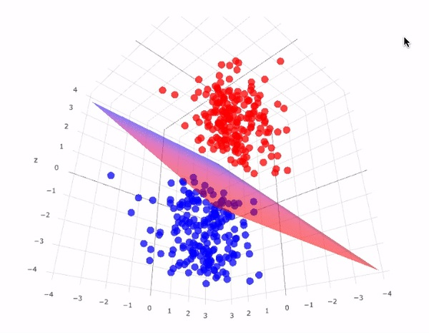
Face Detection - Histogram of oriented gradients
?
How SVM works?
In training phase, SVM finds a optimal hyperplane that divides the dataset into 2 parts (positive and negative)
In prediction phase, SVM uses the hyperplane to finds the part that vector belongs

Slide 28
Face Detection - Histogram of oriented gradients
Out put➔ After finishing face detection, the output will be a frame with face location if the image contains human face

Slide 29
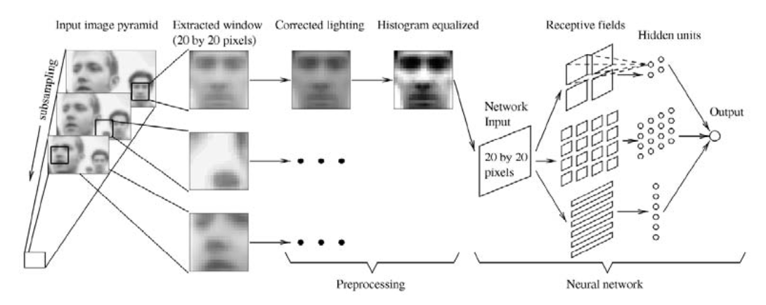
Face Detection - Neural network
Face

Slide 30
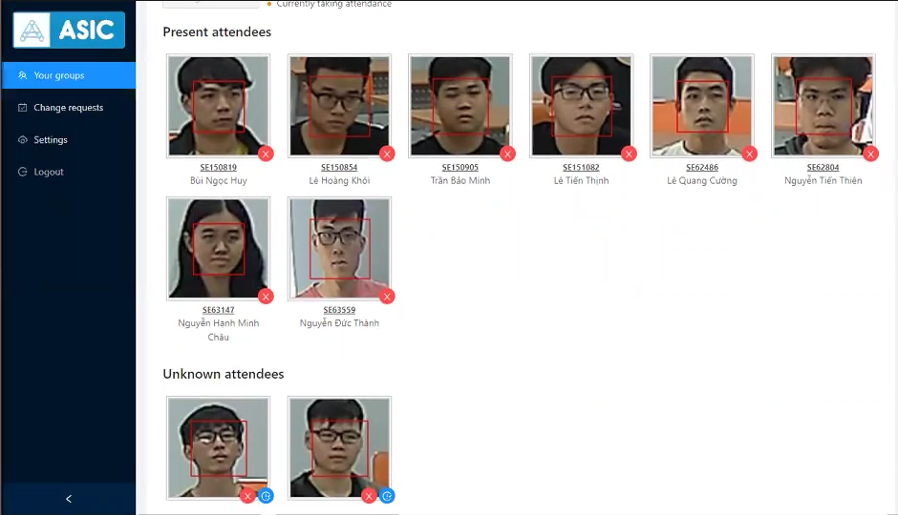
Applications
Facial motion capture
Facial recognition
Photography
Marketing

Slide 31
Challenges
Viewpoint variation
One of the biggest difficulties of object detection is that an object viewed from different angles may look completely different.
Deformation
The subject of computer vision analysis is not only a solid object but also bodies that can be deformed and change their shapes, which provides additional complexity for object detection.
Occlusion
Sometimes objects can be obscured by other things, which makes it difficult to read the signs and identify these objects.

Slide 32
Challenges
Illumination conditions
Lighting has a very large influence on the definition of objects. The same objects will look different depending on the lighting conditions.
Cluttered or textured background
Objects that need to be identified may blend into the background, making it difficult to identify them.
Variety
The same object can have completely different shapes and sizes. Computer vision needs to do a lot of research to read an object and understand what it means.

Slide 33
Challenges
Speed
When it comes to video, detectors need to be trained to perform analysis in an ever-changing environment. It means that object detection algorithms must not only accurately classify important objects but also be incredibly fast during prediction to be able to identify objects that are in motion.

Slide 34
Summary
What is Object Detection?
The techniques used in object detection.
Learn about face detection
Pedestrian detection
Applications of face detection
Object detection challenges

